Slide 1
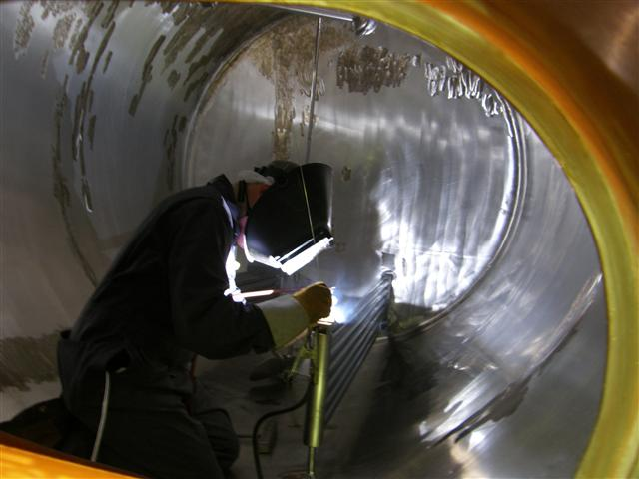
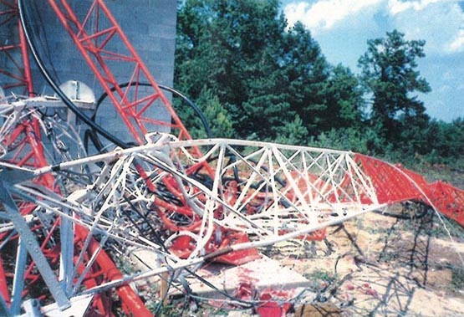
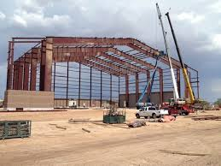
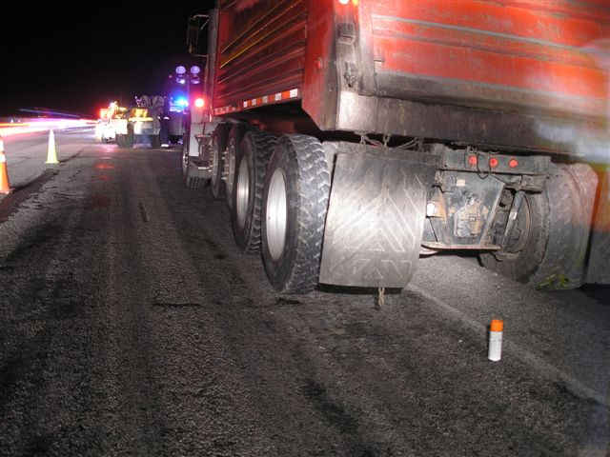
OSHA Construction
Update
Bill McDonald, CSP
Area Director, St. Louis Area Office
Occupational Safety and Health Administration
Notes:
1

Slide 2
Construction Industry Fatalities & Rates*
Years | 2006 | 2007 | 2008 | 2009 | 2010 | 2011 | 2012 | *2013
Total Fatalities All Construction | 1239 | 1204 | 975 | 834 | 774 | 738 | 806 | 796
Fatality Rates All Construction | 11.2 | 10.8 | 9.7 | 9.9 | 9.8 | 9.1 | 9.9 | 9.4
Source: BLS CFOI Data
*2013 Data is Preliminary

Slide 3
Leading Causes of Construction Fatalities
Cause | Fatalities 2011 | Fatalities 2012 | Fatalities 2013*
FALL TO LOWER LEVEL | 255 | 281 | 284
STRUCK BY | 73 | 79 | 82
ELECTROCUTION | 69 | 66 | 71
CAUGHT IN/BETWEEN | 18 | 13 | 21
Source: BLS Table A-9 for Each Year Shown
*2013 Numbers are preliminary
Notes:
Updated – 07/08/2014
BLS 2013 Numbers are Preliminary

Slide 4
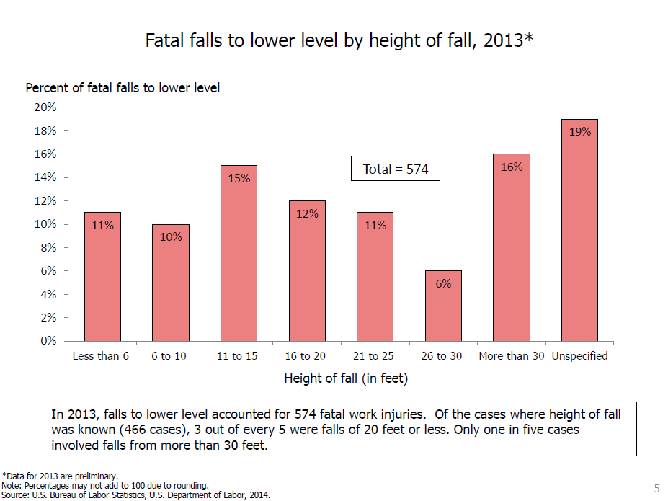

Slide 5
FY 2010 – FY 2014
Inspections Conducted
Data Source: OIS Insp. Summary Rpt. Dated 11/12/2014
Notes:
Total Inspections – Sum of all Programmed & Unprogrammed inspections conducted
For FY14, actual inspection total was 36,163. It is estimated that another 1,500 inspections would have occurred without the government shutdown.
Year over year decline for one reason is that the goal is internally determined roughly off of field/regional available staff/FTE . Since 2010, attrition and sequestration has reduced the size of OSHA and reduced the number inspections conducted.

Slide 6
FY 2012 – FY 2015* Inspections Conducted
Data Source: OIS Insp. Summary Rpt. Dated 11/12/2014
FY15 data is through 3/1/15
Notes:
Emphasis on health inspections. OSHA looking to increase health inspections year over year.

Slide 7
FY 2012 – FY 2015* Inspections Conducted
Data Source: OIS Insp. Summary Rpt. Dated 11/12/2014
FY15 data is through 3/1/15
Notes:
Shift away from construction to general industry. Could be one reason we are seeing less total violations per year and less number of inspections per year.
OSHA Expects to be at 50% Construction and General Industry by the end of FY2015.

Slide 8
FY 2010 – FY 2014
% Inspections In-Compliance
Data Source: OIS Insp. Summary Rpt. Dated 11/12/2014
Notes:
* The rate is based on closed inspections with no violations issued divided by closed inspections PLUS Open inspections with violations
Tom, food for thought…..I/C rate increasing with number of inspections decreasing and there is one more possible reason for the reduction in violations issued.

Slide 9
FY 2010 – FY 2014
% Complaint Inspections
Data Source: OIS Insp. Summary Rpt. Dated 11/12/2014
FY15 data is through 3/1/15
Notes:
% Total Inspections conducted and Inspection Type was Complaint. Increase in worker voice in the workplace.
Following slides indicate where the complaints coming from?

Slide 10
Severe Violator Enforcement Program (SVEP) Criteria
Case designated as SVEP case if:
  SVEP-Fatality: ≥ 1 or more willful/ repeat/ failure-to-abate violation (WRFTA)
  SVEP-HEH: ≥2 high-gravity WRFTA related to a High-Emphasis Hazard
  SVEP-PSM: ≥3 high-gravity WRFTA related to PSM standard
  SVEP-Egregious: any egregious case
Notes:
establishes enforcement policies and procedures for OSHA's Severe Violator Enforcement Program (SVEP), which concentrates resources on inspecting employers who have demonstrated indifference to their OSH Act obligations by committing willful, repeated, or failure-to-abate violations. Enforcement actions for severe violator cases include mandatory follow-up inspections, increased company/corporate awareness of OSHA enforcement, corporate-wide agreements, where appropriate, enhanced settlement provisions, and federal court enforcement under Section 11(b) of the OSH Act.
High-emphasis hazards are those OHSA has identified as high risk. High-Emphasis Hazard includes grain handling.

Slide 11
SVEP Cumulative Summary
Period of review: 6/18/2010 – 2/27/2015
485 SVEP cases
  124 (26%) of the 485 SVEP cases are fatalities
  35 (8 %) of 485 SVEP cases are egregious, 5 of which were also fatalities
  326(67 %) of the 485 SVEP cases are Non-fatality/Catastrophe Criterion Related to a High-Emphasis Hazard.
  5 (2%) of the 485 SVEP cases are Non-fatality/Catastrophe for Hazards Due to the Potential Release of a Highly Hazardous Chemical (Process Safety Management)
295 (60 %) of the 485 SVEP cases are in construction
  46 (16 %) of the 285 SVEP construction cases are fatalities
Notes:
Employer size break out
6/18/2010 – 1/31/2014
1-25 employees: 257 cases (54%)
26-100 employees: 99 cases (21%)
101-250 employees: 38 cases (8%)
250+ employees: 58 cases (17%)
The cumulative log is posted on OSHA’s website to the public and it is updated quarterly for the public.

Slide 12
Top 10 Most Cited Standards
St. Louis Area Office-FY14
(Construction)
1926.501(b)(13) Residential Fall Protection
1926.102(a)(1) Eye & Face Protection
1926.1053(b)(1) Ladders
1926.503(a)(1) Fall Protection Training
1926.020(b)(2) Jobsite Inspections
1926.100(a) Head Protection
1926.501(b)(1) Duty to Have Fall Protection
1926.501(b)(10) Fall Protection-Low Slope
1926.021(b)(2) Safety Training
1926.451(g)(1)(i) PFAS for Ladder Jack Scaffolds

Slide 13

St. Louis Area Office
National/Local/Regional Emphasis Programs
Construction
Falls/Overhead Powerlines
Trenching
Struck-by Vehicle
“Dodge Reports”
Notes:
13
13

Slide 14
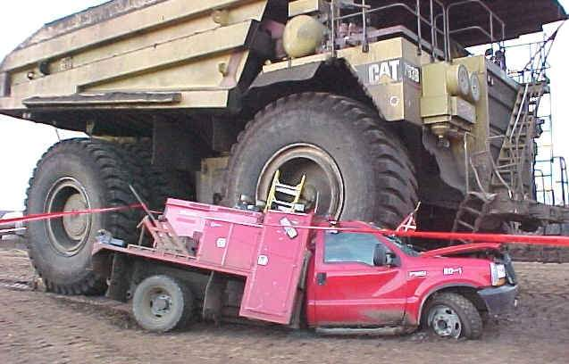
Struck By Vehicles REP
FY 13- 14 Compliance Assistance
FY 15 Adds Enforcement

Slide 15
Background
From fiscal years 2011-2013, 36 percent (24 of 67) of Region VII accident investigations were vehicle-related struck-by fatalities. These investigations resulted in an average of 4 violations per inspection.

Slide 16
Scope
Address hazards associated with the operation of material handling or personnel handling motorized equipment (including but not limited to powered industrial trucks, skid steers, cranes, man lifts, front-end loaders, aerial lifts, etc.) in general industry, construction and maritime.
Compliance with all applicable vehicle-related standards shall be evaluated during all general industry, construction, and maritime inspections.

Slide 17
Scope (cont.)
All complaints will be inspected regardless of when last observed by the complainant.
Any referral or other complaint classified by OSHA as “Serious” which alleges a material or personnel handling motorized equipment hazard or a condition will be scheduled for an inspection if the condition was observed by the complainant within two weeks of notification.

Slide 18
New OSHA Reporting Requirements
(Effective January 01, 2015)
Required 24 hour reporting
  Any work related hospitalizations
    One or more employees
  Amputations
    One or more employees
  Loss of an eye
    One or more employees
Required 8 hour Reporting of fatalities and catastrophe
Notes:
New Reporting Requirements for Fatalities and Severe Injuries
All work-related hospitalizations, amputations and loss of an eye will have to be reported to the Occupational Safety and Health Administration, according to a final rule taking effect on Jan. 1, 2015. Under the newly revised rule, employers under federal OSHA's jurisdiction will be expected to report any fatality to OSHA within 8 hours, and any in-patient hospitalization, amputation or enucleation within 24 hours. Previously, employers were required only to report fatalities, and when three or more workers were hospitalized. Though all employers will have to adhere to the new reporting requirements for fatalities and severe injuries, the rule also updates the list of industries partially exempt from routinely keeping injury and illness logs. The new rule will help OSHA focus compliance assistance and enforcement resources to better protect workers and prevent more workplace injuries, illnesses and fatalities.

Slide 19


www.osha.gov
How can employers report to OSHA?
By telephone to the nearest OSHA office during normal business hours.
By telephone to the 24-hour OSHA hotline (1-800-321-OSHA or 1-800-321-6742).
Online: OSHA is developing a new means of reporting events electronically, which will be available soon at www.osha.gov/report_online.
Notes:
19

Slide 20

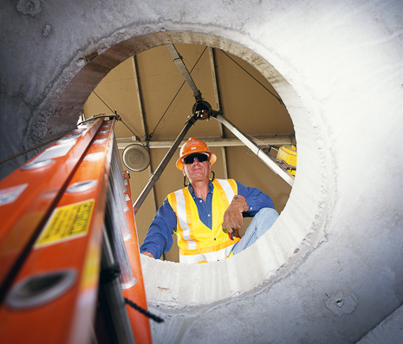
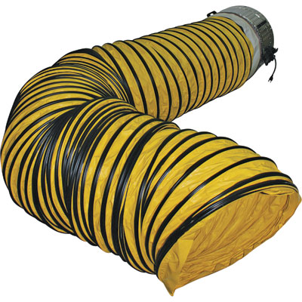
Directorate of Construction Standards
  Confined Spaces
Notes:
Now Under OMB Review

Slide 21
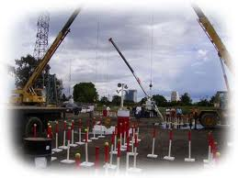
Crane Final Rule Update
Railroads and Railroad Right of Way
  Settlement agreement finalized
Cranes and derricks amendments
3 year extension for certification
  FRN Published September 26, 2014
Employers must ensure crane operators are competent to operate the crane safely
  If not competent….employer must ensure the operator is trained
Notes:
Settlement Agreement with Association of American Railroads
- Reached agreement on September 2, 2014
- OSHA issued a letter of interpretation clarifying modification requirements of railroad cranes.
- OSHA must do rulemaking to clarify other railroad crane requirements.
Final Rule- Extending Effective Dates for Certification and Employer Duty Requirements
- Issued on September 26. 2014
- Extended effective dates to provide time for revisiting capacity and certification issues.

Slide 22


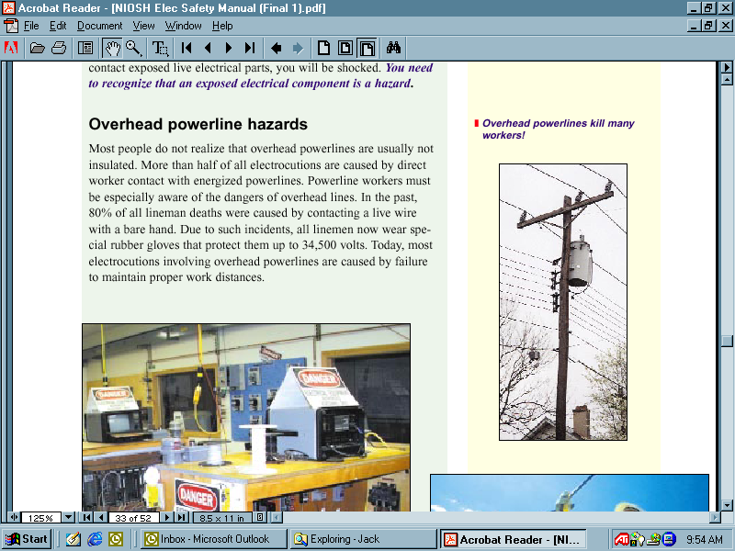
Subpart V Power Transmission and Distribution Update
Notes:
Final Publication On or About April 2, 2014 -
Settlement Agreement between OSHA and Edison Electric (EEI), the Utility Line Clearance Coalition (ULCC) and the Tree Care Industry Association(TCIA) was agreed on signed about 13 February, 2015

Slide 23
OSHA Outreach & Collaborations
OSHA is strengthening relationships with NATE and other industry stakeholders
Addressing hazardous conditions through outreach
    Agency sent letters to over 100 communication tower companies, including 26 state wireless associations
October 14, 2014 workshop
  - Involved stakeholders from all sectors of industry
  - Joint OSHA/FCC best practices document
Notes:
In 2015 OSHA plans to broaden OSHA collaboration with industry working groups, Government agencies, and individual stakeholders

Slide 24
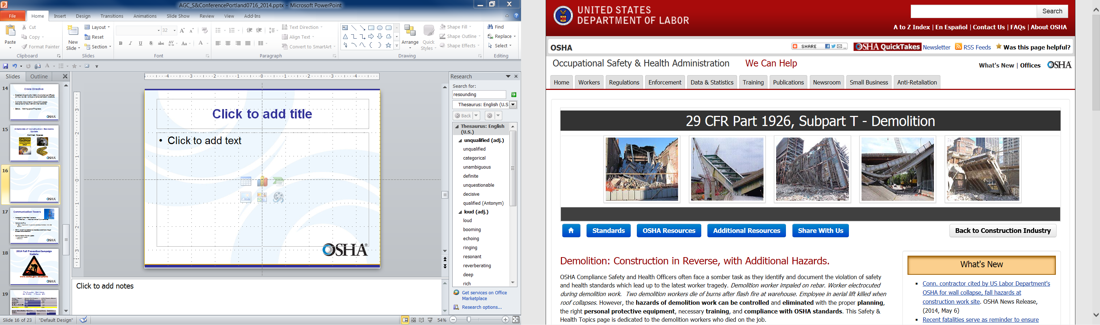
Notes:
New Demolition Webpage
Mention The NY and NJ incidents.

Slide 25

Notes:
DOC Web page:
http://http://www.osha.gov/doc/index.html

Slide 26
Fatal Falls in Residential Construction
2003 - 2013
Source of fatality data: Bureau of Labor Statistics
Source of housing starts: McGraw-Hill Construction

Slide 27

May 4-15, 2015
National Safety Stand-down
Notes:
Join the National Safety Stand-down to Prevent Falls in Construction
May 4-15, 2015

Slide 29

Questions?

